Slide 1
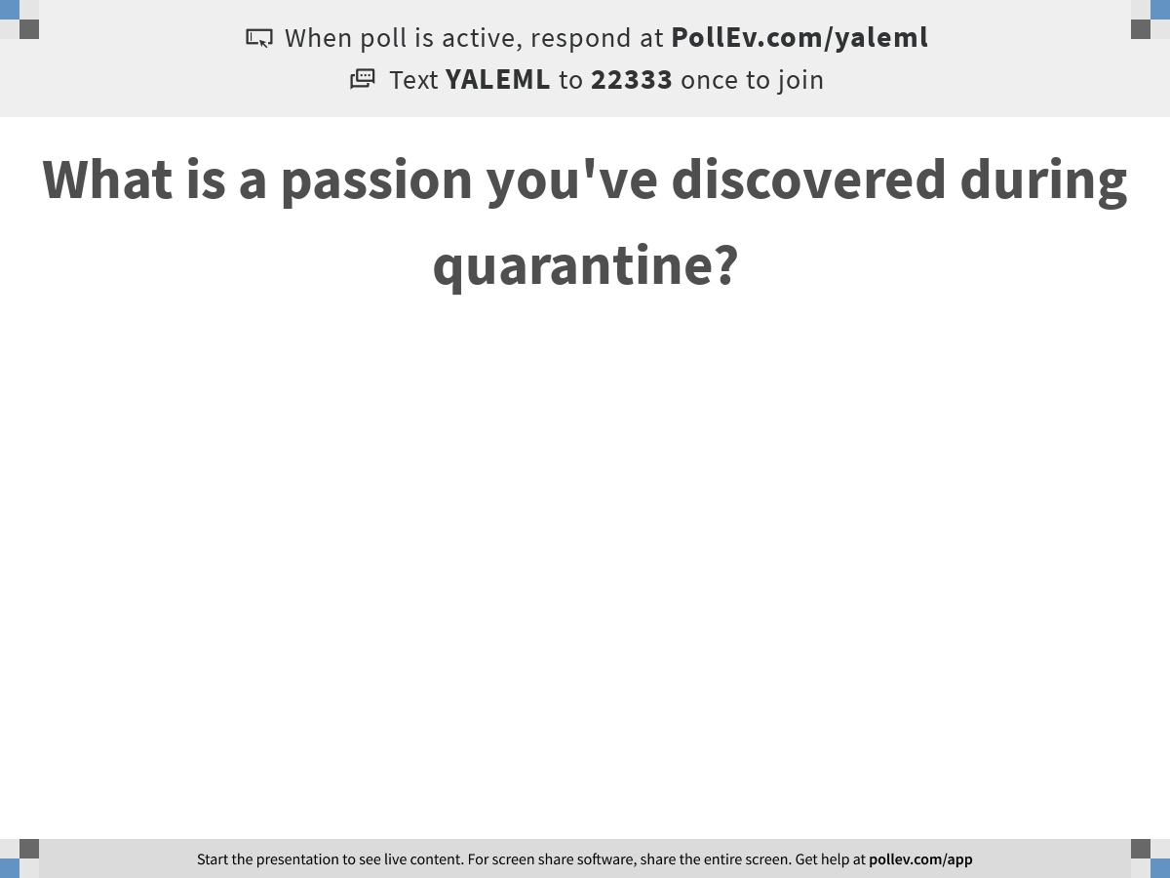
Notes:
What is a passion you've discovered during quarantine?
https://www.polleverywhere.com/free_text_polls/ji3e941oREI1Wky1RJ2Dx

Slide 2

Recap from Day 2
Notes:
TA introduction
Talk about not teaching code (not a programming workshop)

Slide 3
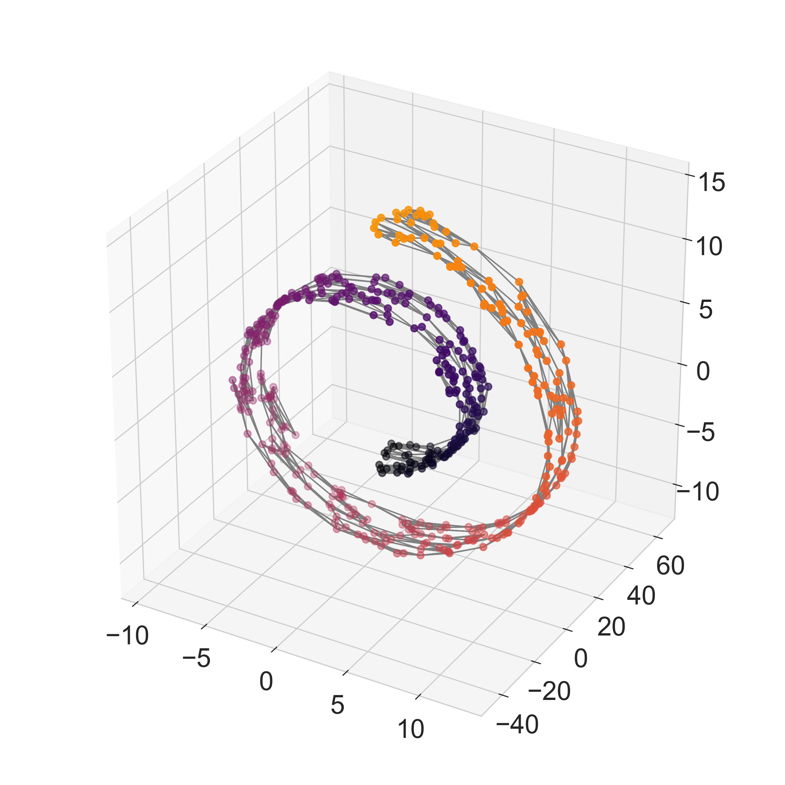
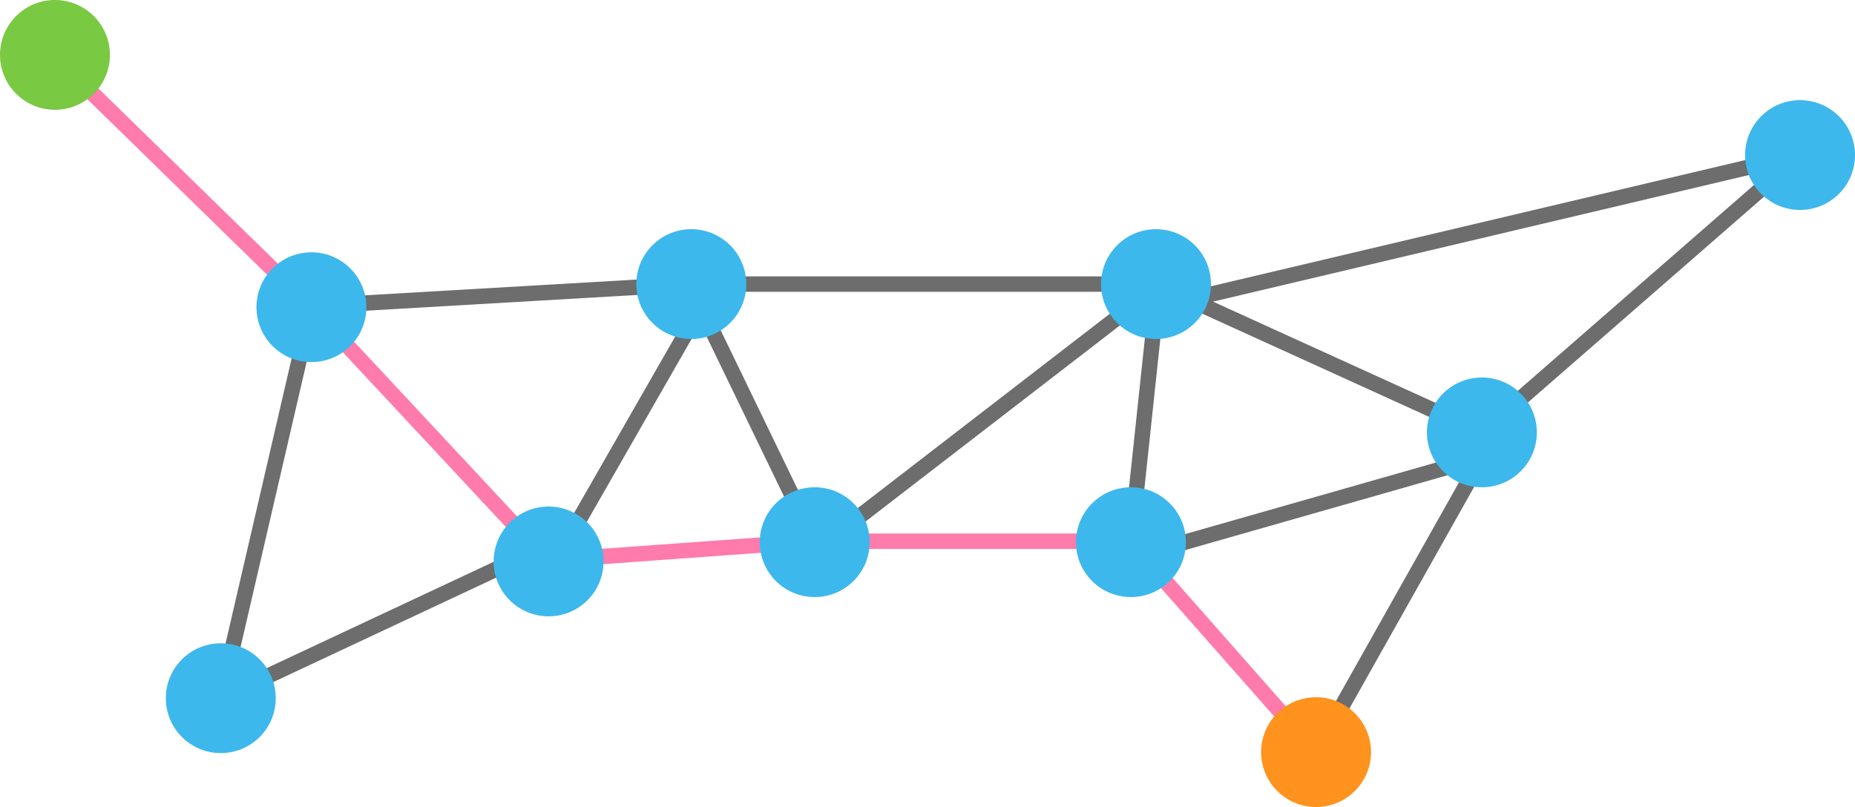
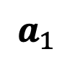
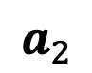
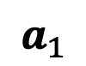
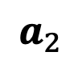
Paths or “walks” on graphs reveal dominant data manifold directions
Shortest path between points
$$a_{1}$$
$$a_{1}$$
$$a_{2}$$
$$a_{2}$$

Slide 4

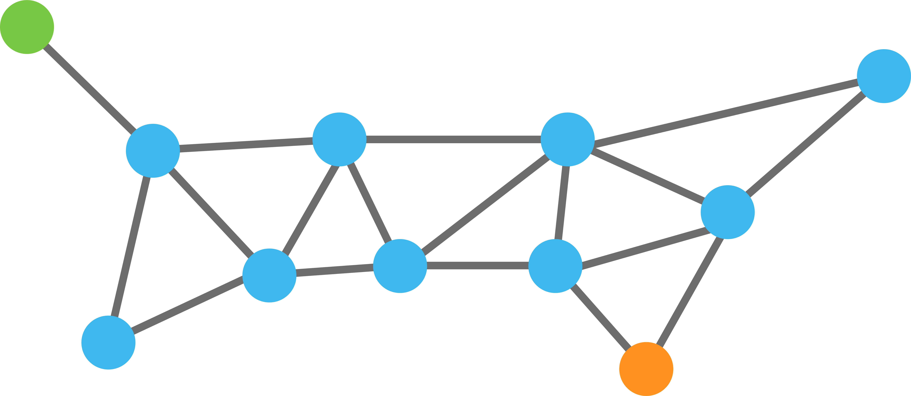
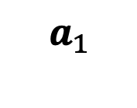
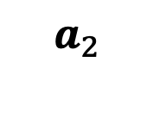
Paths or “walks” on graphs reveal dominant data manifold directions
$$a_{1}$$
P=1
$$a_{2}$$

Slide 5
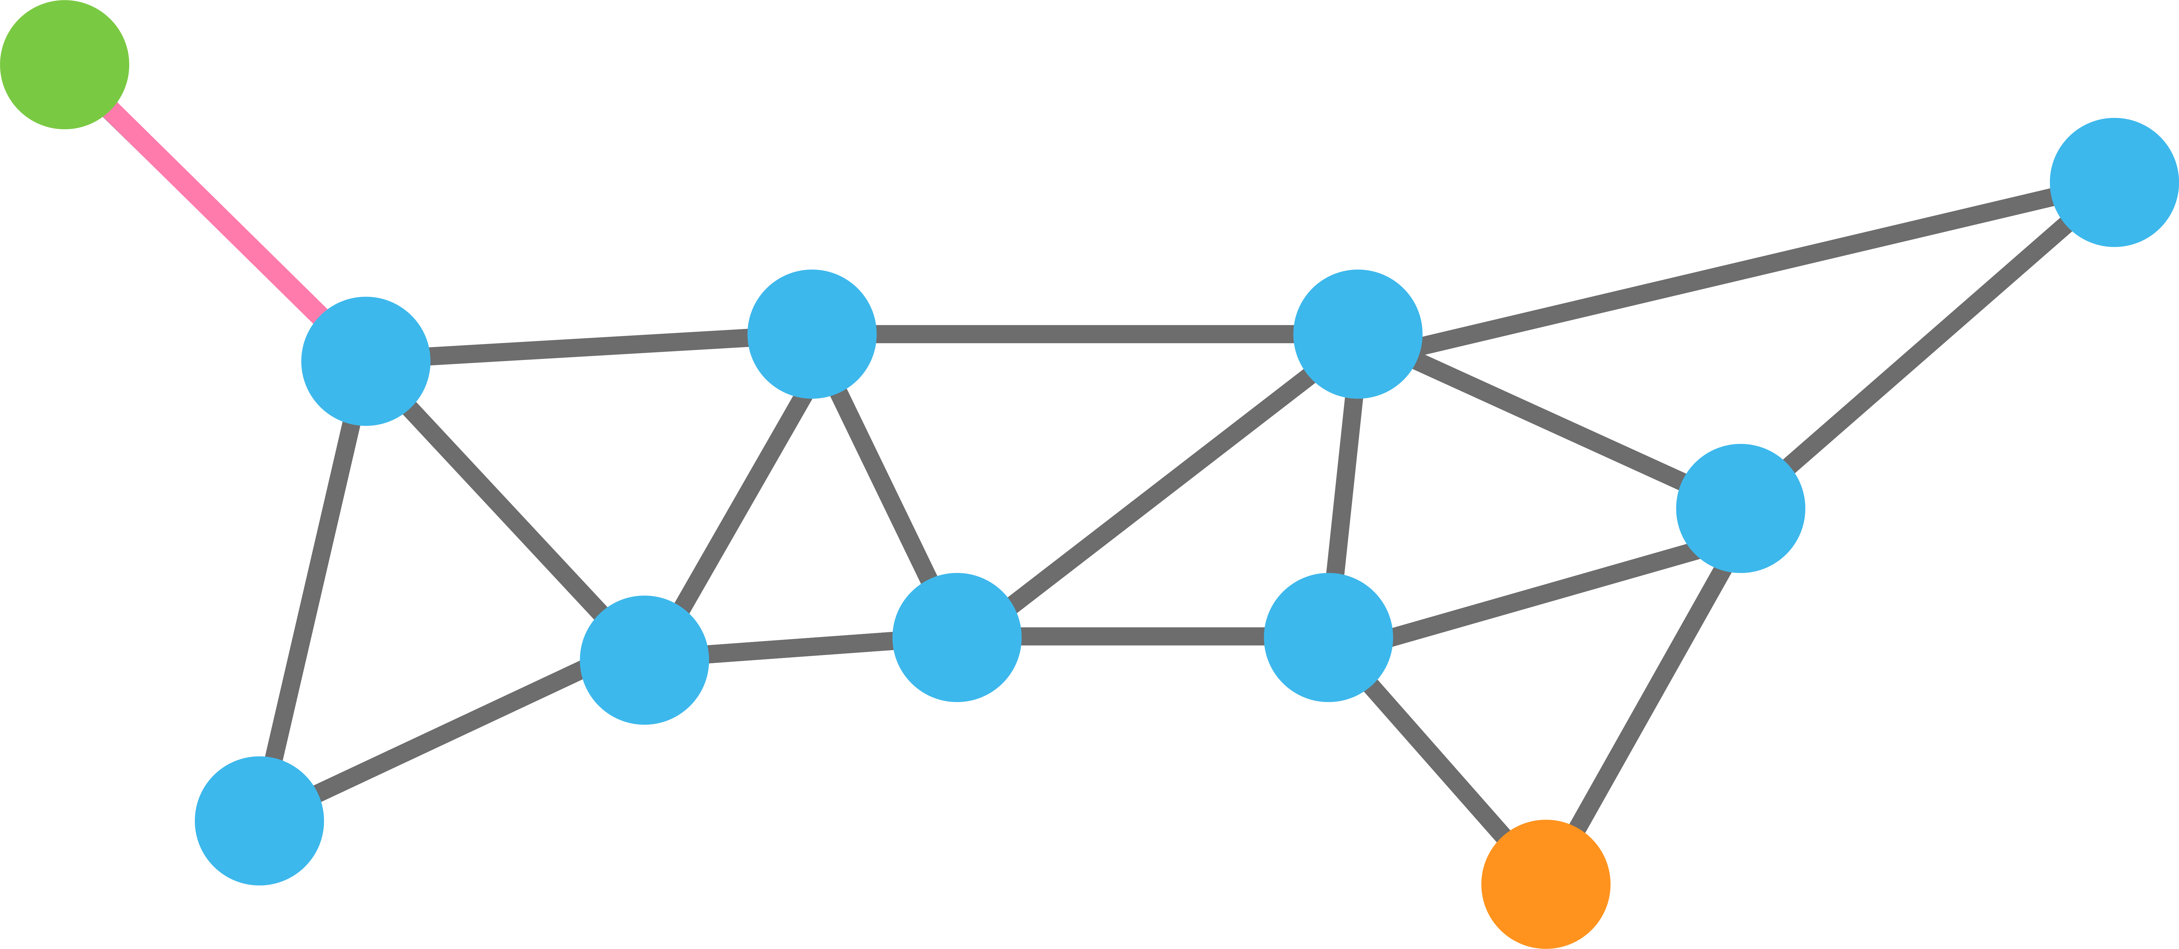
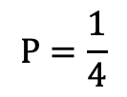
Paths or “walks” on graphs reveal dominant data manifold directions
$$a_{1}$$
$$P=\frac{1}{4}$$
.25
.25
.25
$$a_{2}$$

Slide 6

Paths or “walks” on graphs reveal dominant data manifold directions
$$a_{1}$$
.25
.25
.25
.25
$$a_{2}$$

Slide 7

Paths or “walks” on graphs reveal dominant data manifold directions
$$a_{1}$$
.2
.2
.2
.2
.2
$$a_{2}$$

Slide 8

Paths or “walks” on graphs reveal dominant data manifold directions
$$a_{1}$$
$$a_{2}$$
Steps = 5

Slide 9
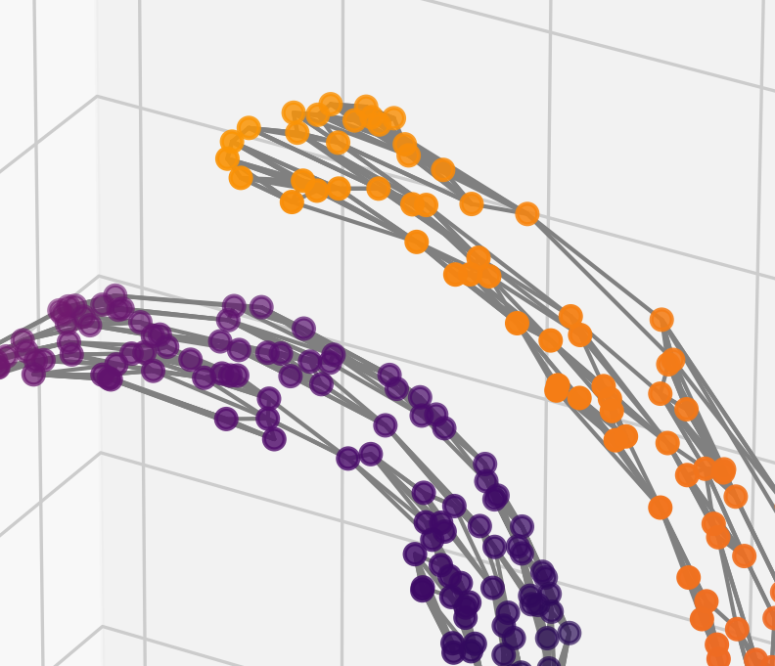
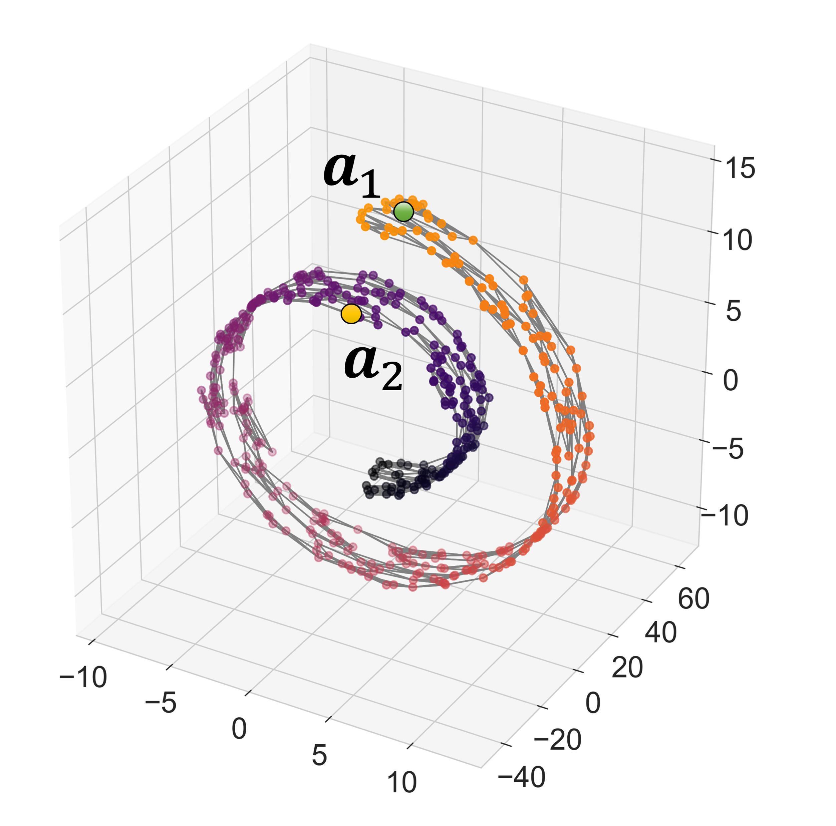
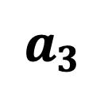
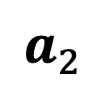
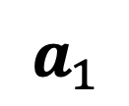
$$a_{1}$$
$$a_{3}$$
$$a_{2}$$

Slide 10
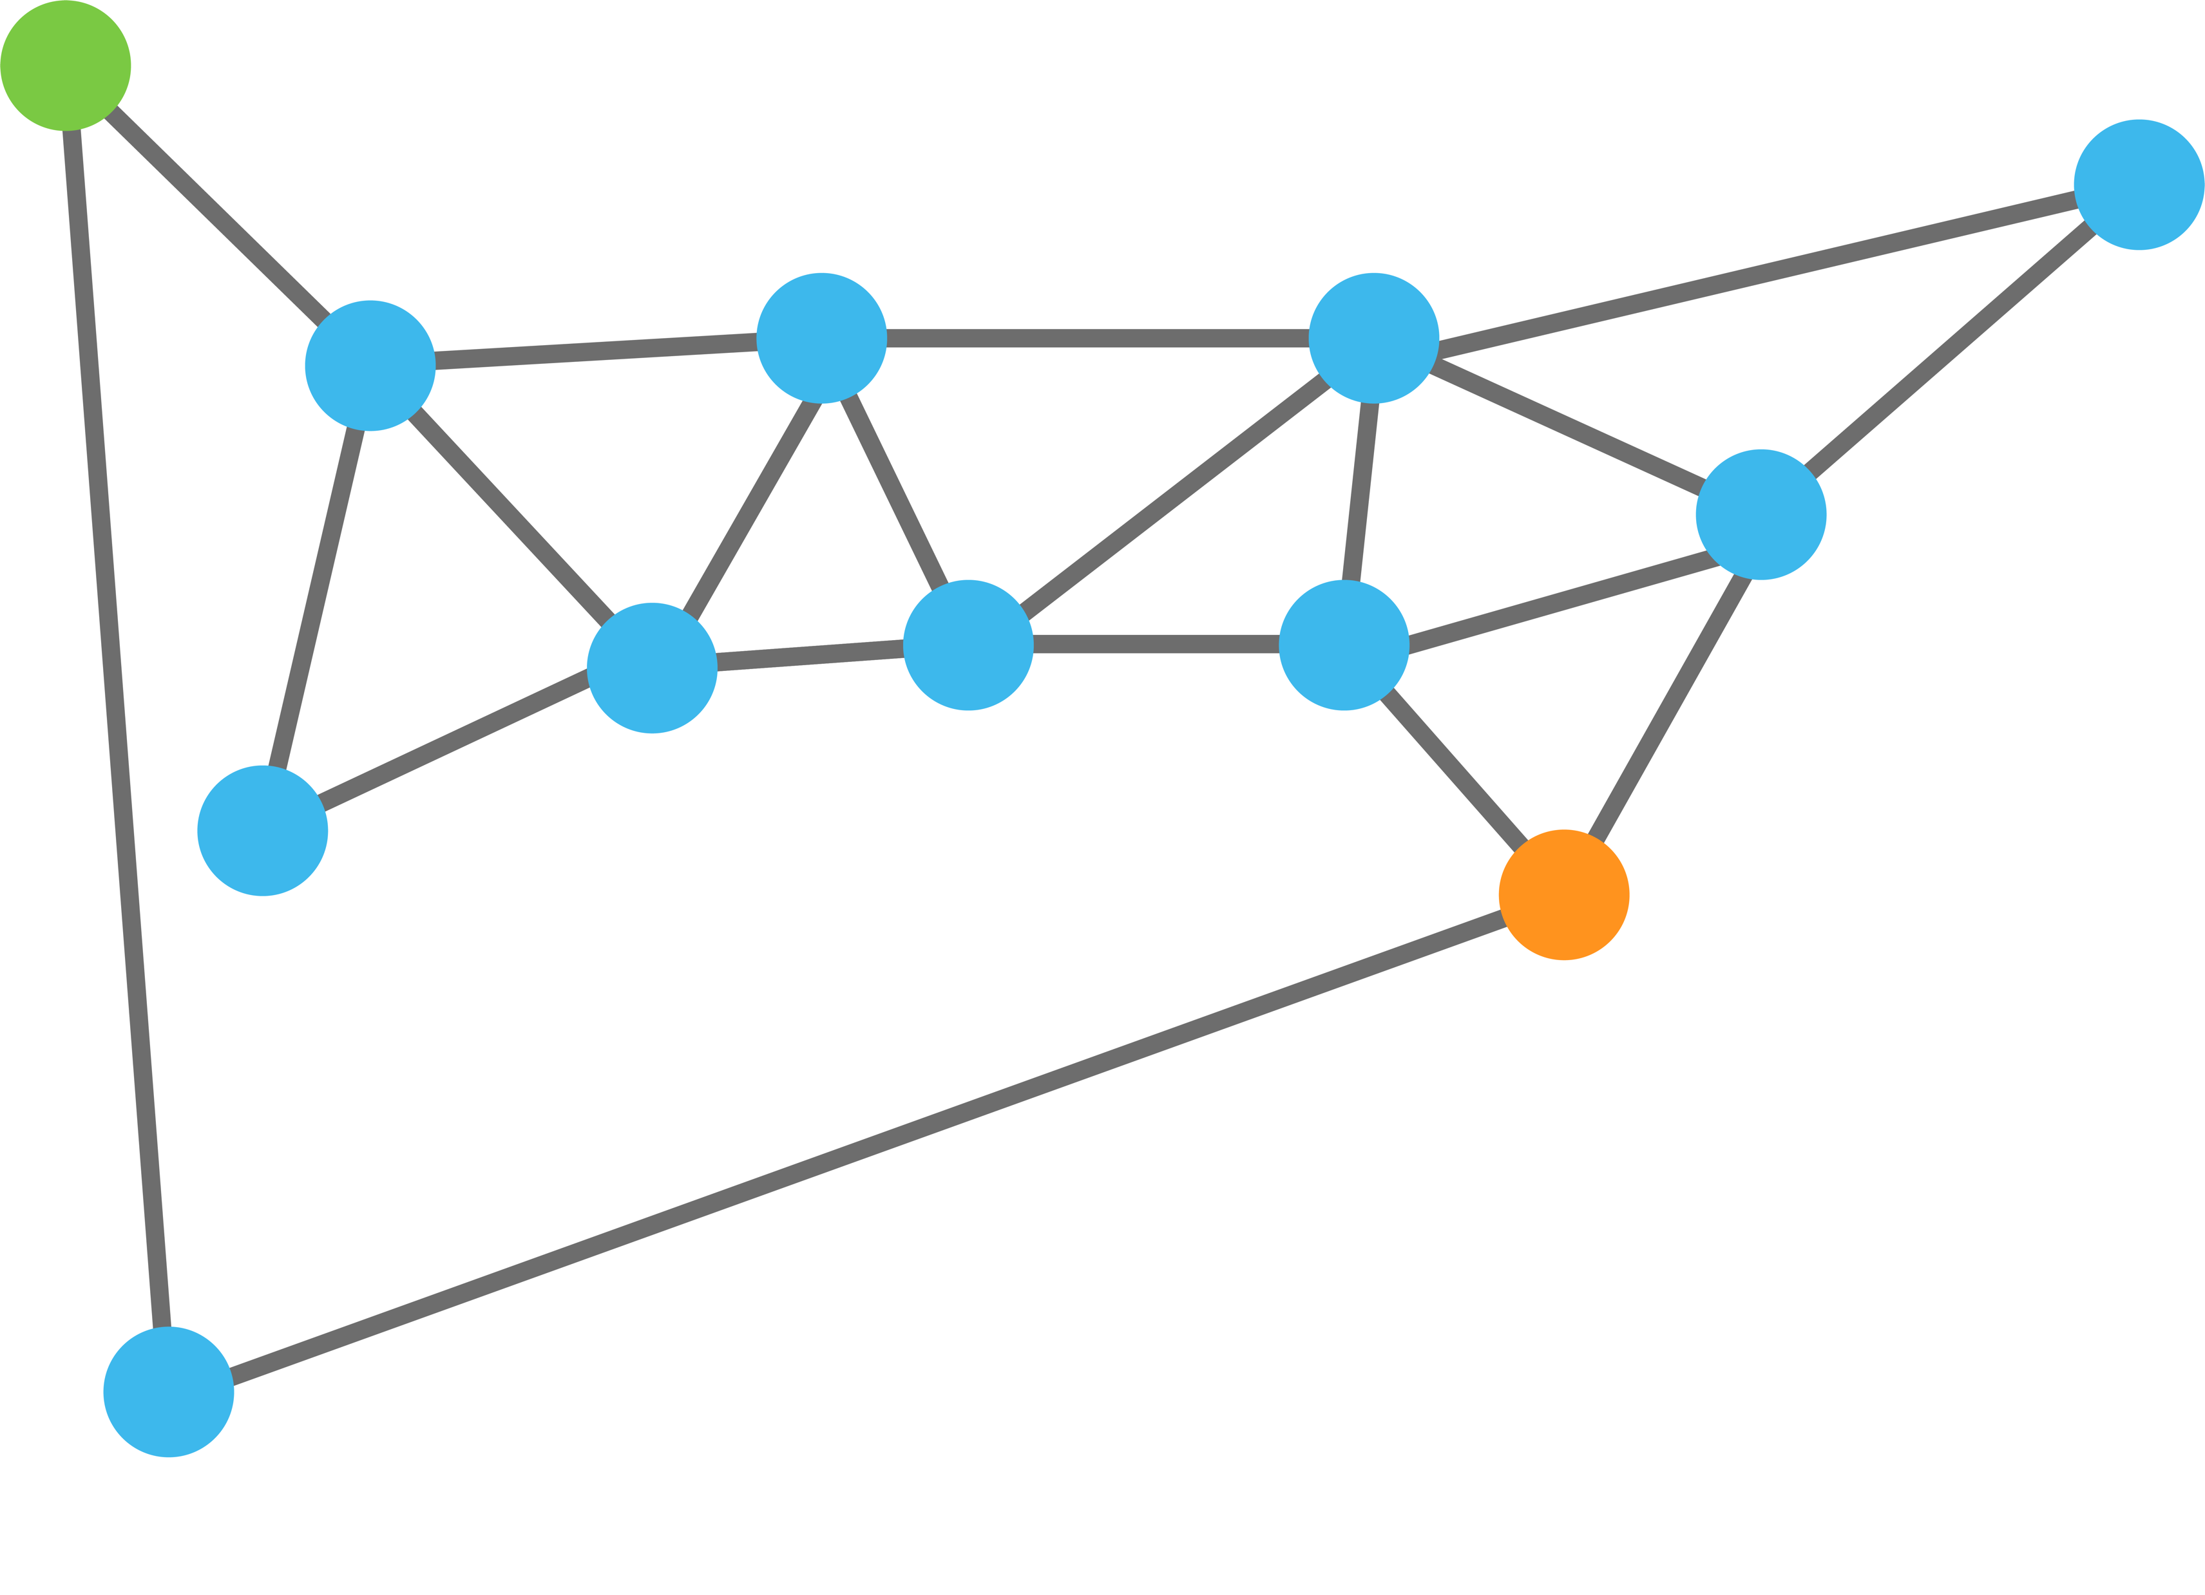
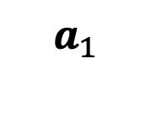
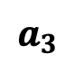
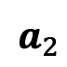
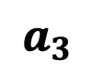
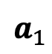
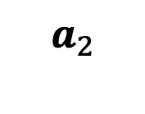
$$a_{1}$$
$$a_{1}$$
$$a_{3}$$
$$a_{2}$$
$$a_{2}$$
$$a_{3}$$

Slide 11
$$a_{1}$$
.9
$$a_{1}$$
.1
$$a_{3}$$
$$a_{2}$$
$$a_{2}$$
$$a_{3}$$

Slide 12
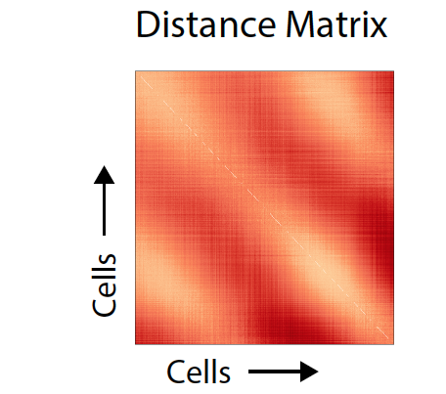
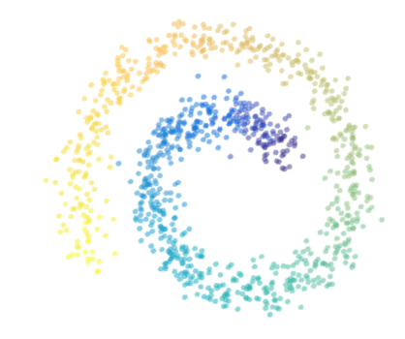
Distance Matrix
Entries are distances
$$D\left(x_{i},x_{j}\right)=\sqrt{||x_{i}−x_{j}}||$$

Slide 13
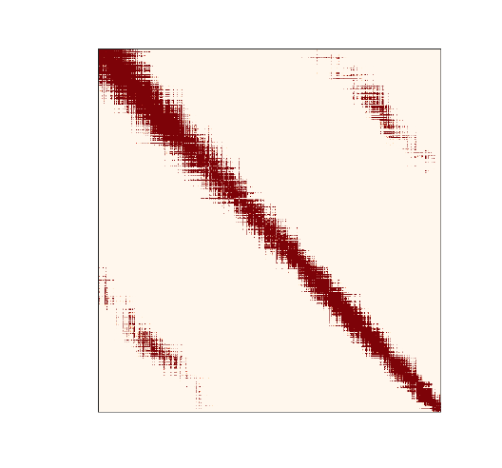
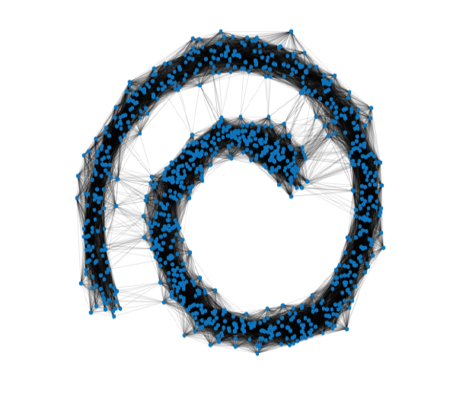
Affinity Matrix
(Gaussian Kernel)
Graph Representation
Entries are affinities
$A\left(x_{i},x_{j}\right)=exp⁡(− \frac{{D(x_{i},x_{j})}^{2}}{σ}$)

Slide 14
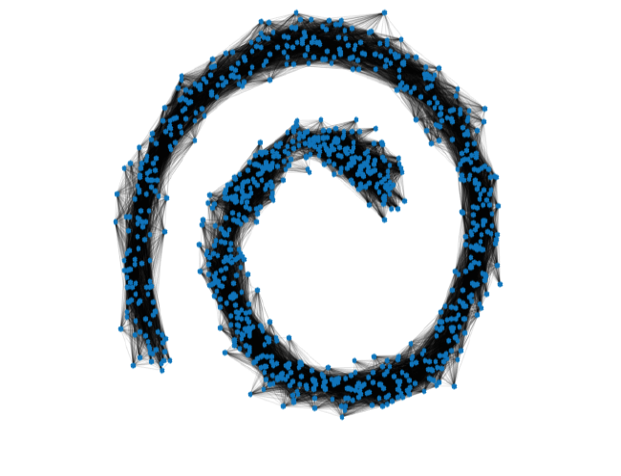
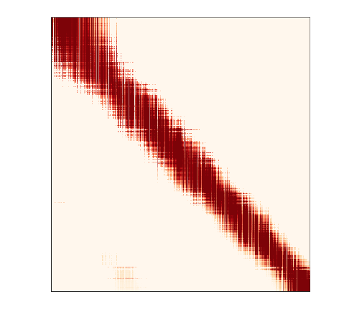
Powered Markov Matrix—Denoises the Affinities (relationship between points)
Powered Markov Matrix
Entries are row normalized affinities
M$\left(x_{i},x_{j}\right)$=$\frac{A\left(x_{i},x_{j}\right) }{\sum_{j}{A\left(x_{i},x_{j}\right) }}$

Slide 15
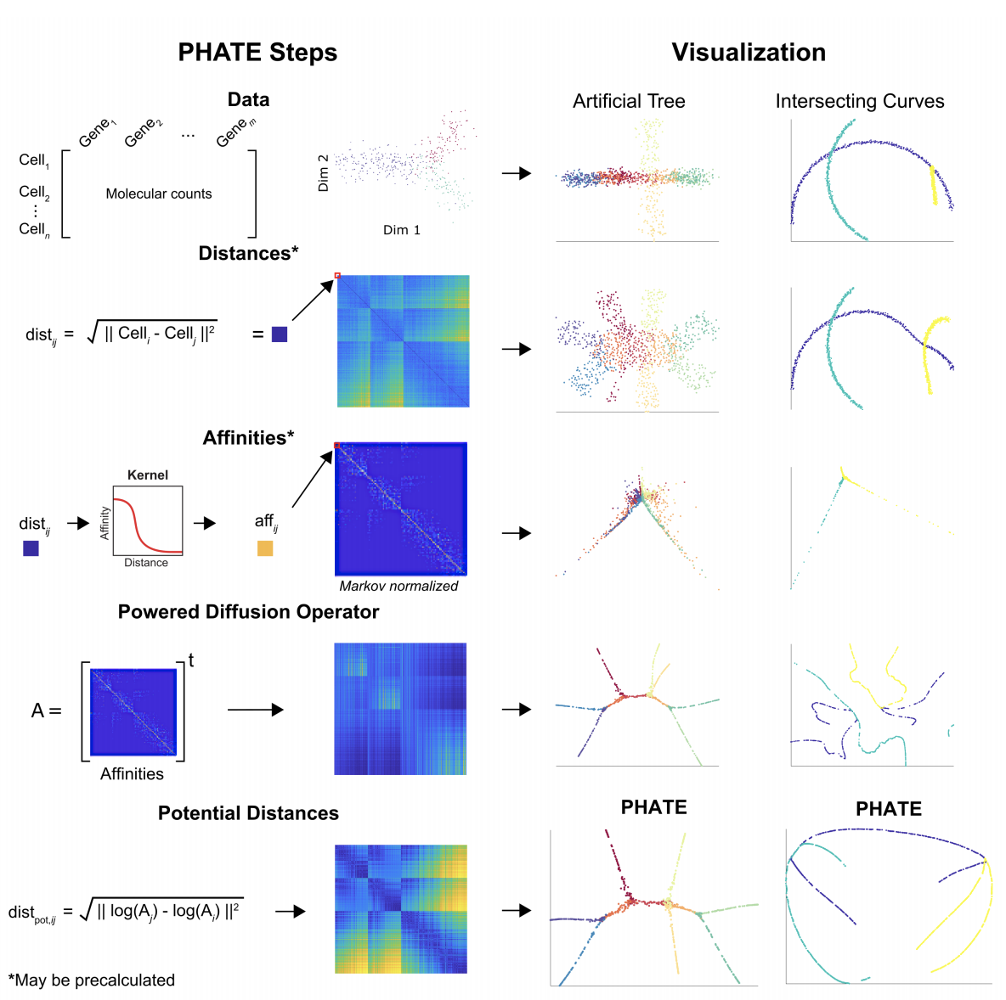
(PCA)
(MDS)
(tSNE)
(DMs)

Slide 16
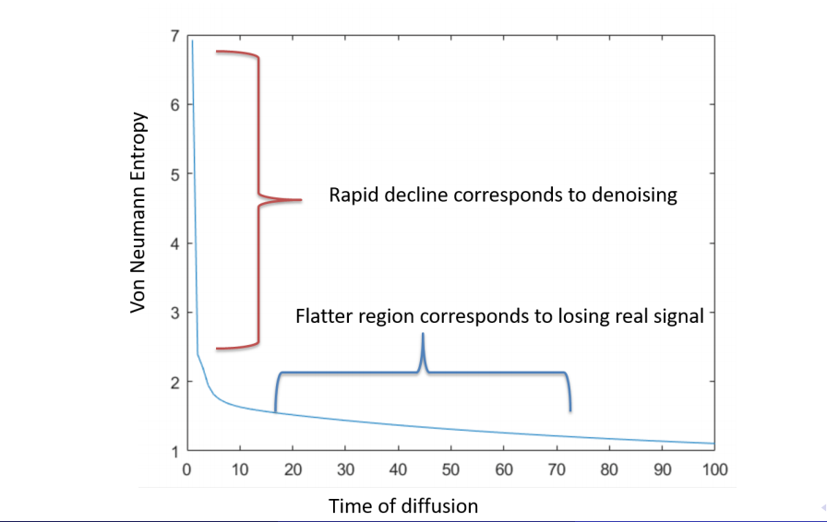
Time of Diffusion t

Slide 17
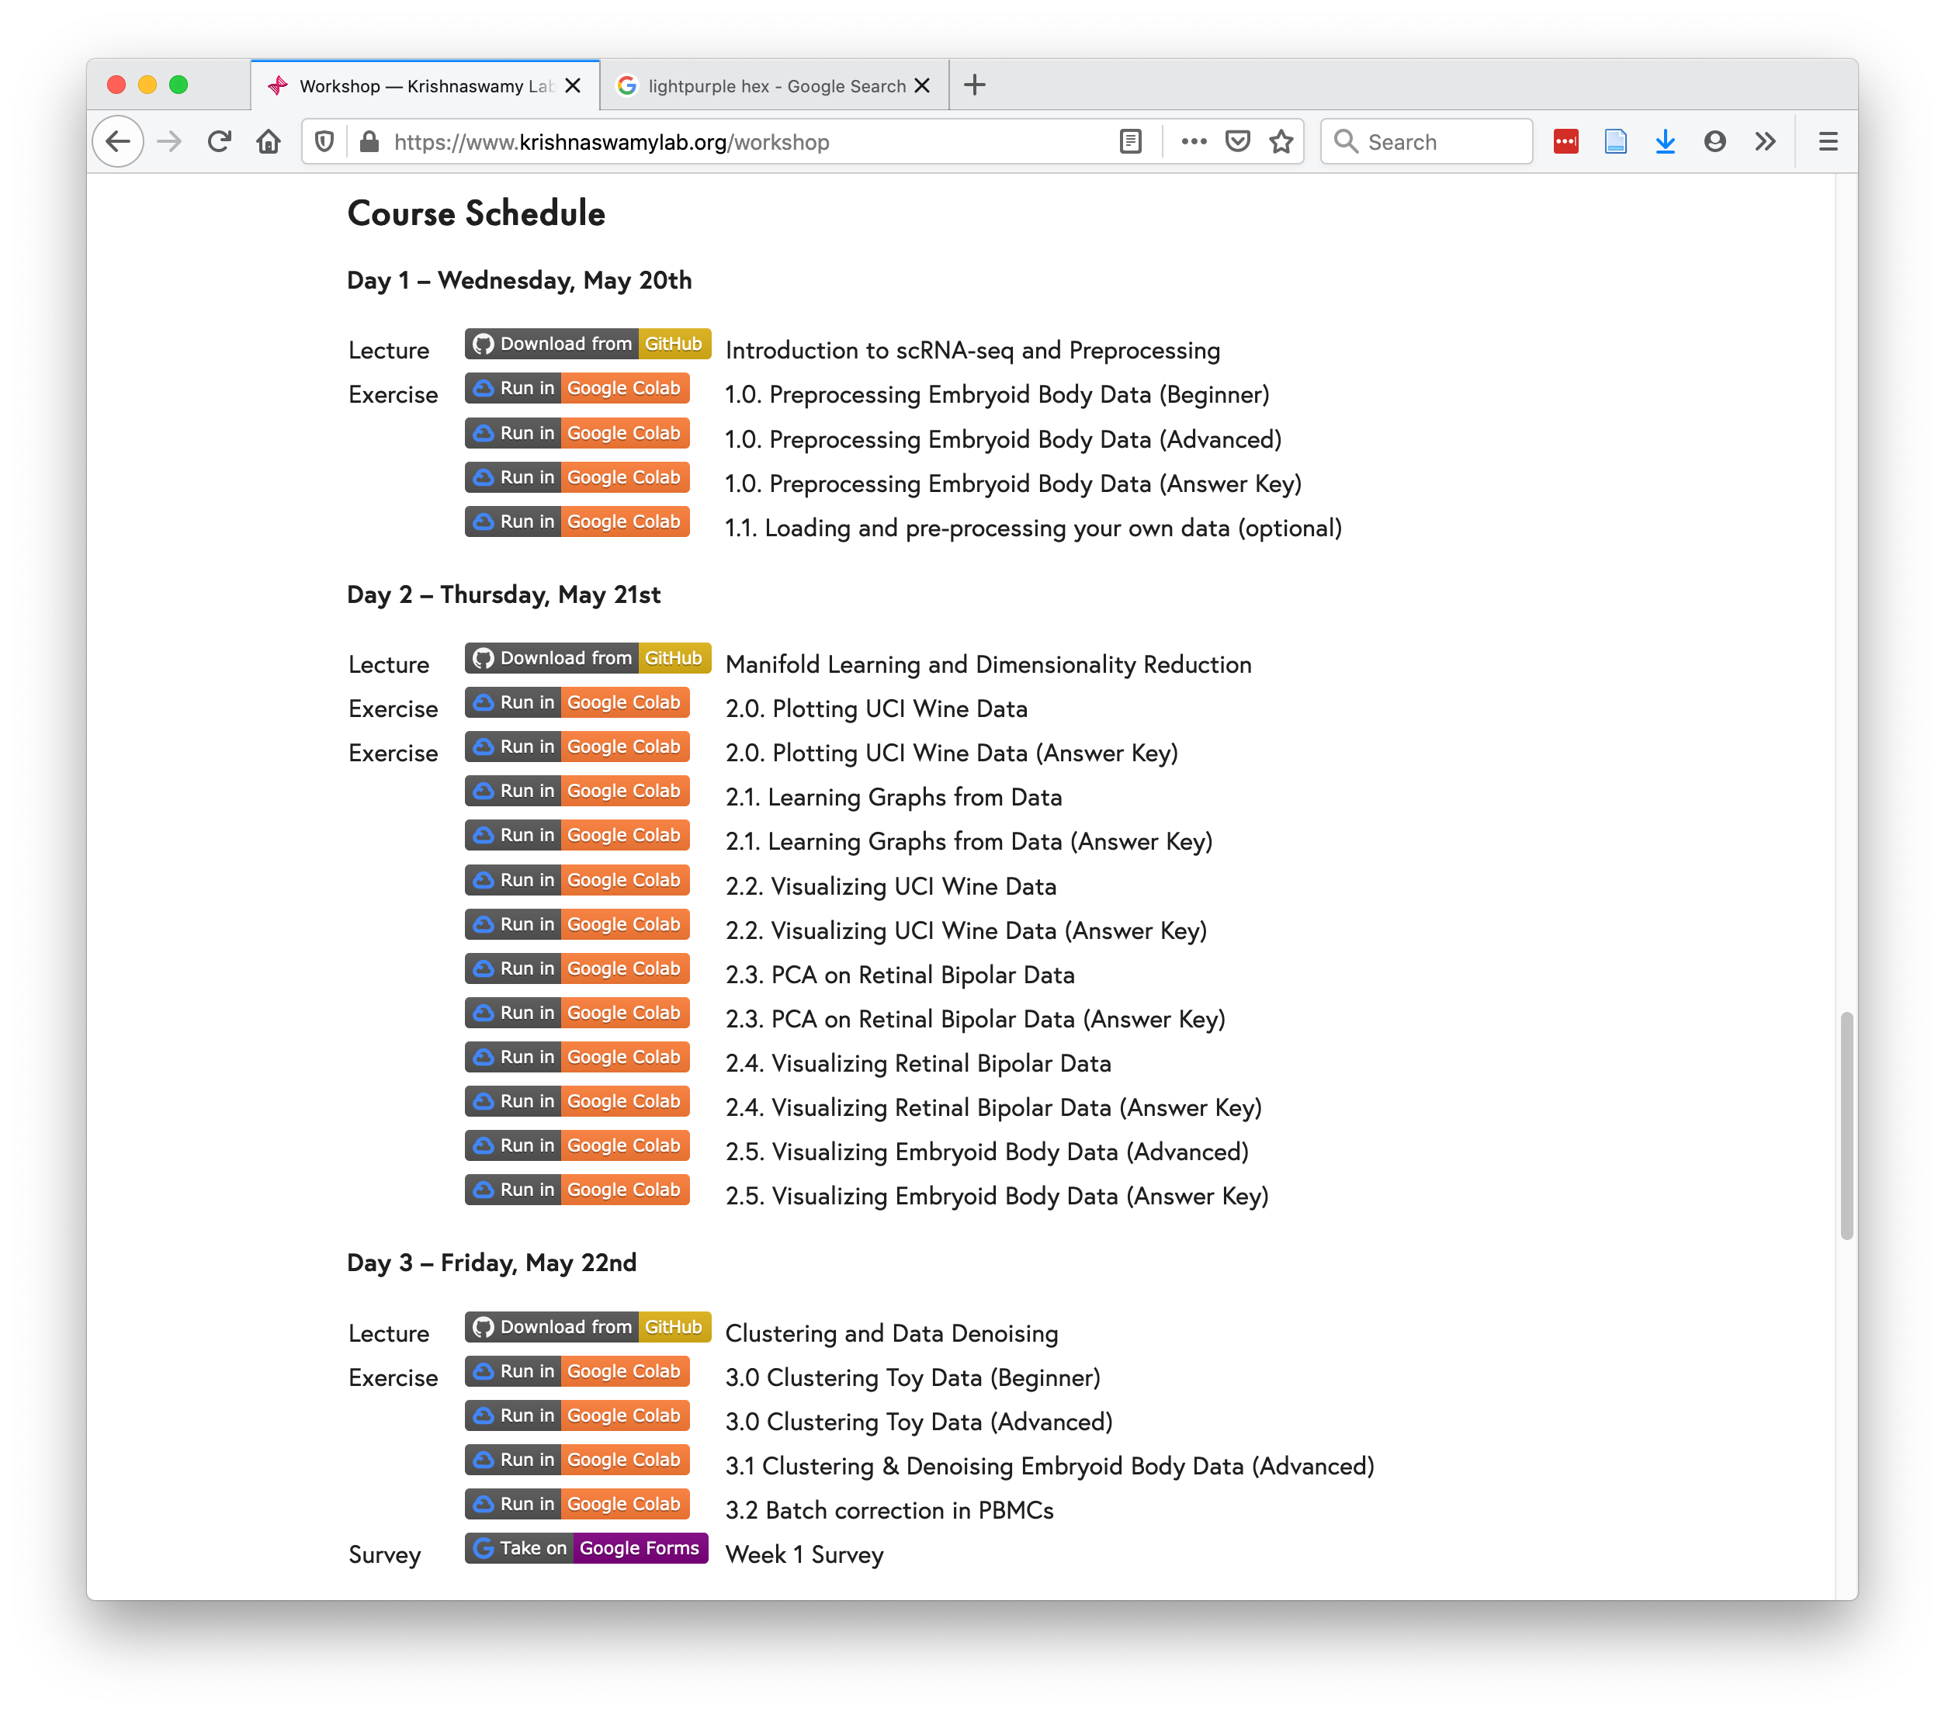
https://www.krishnaswamylab.org/workshop

Slide 18
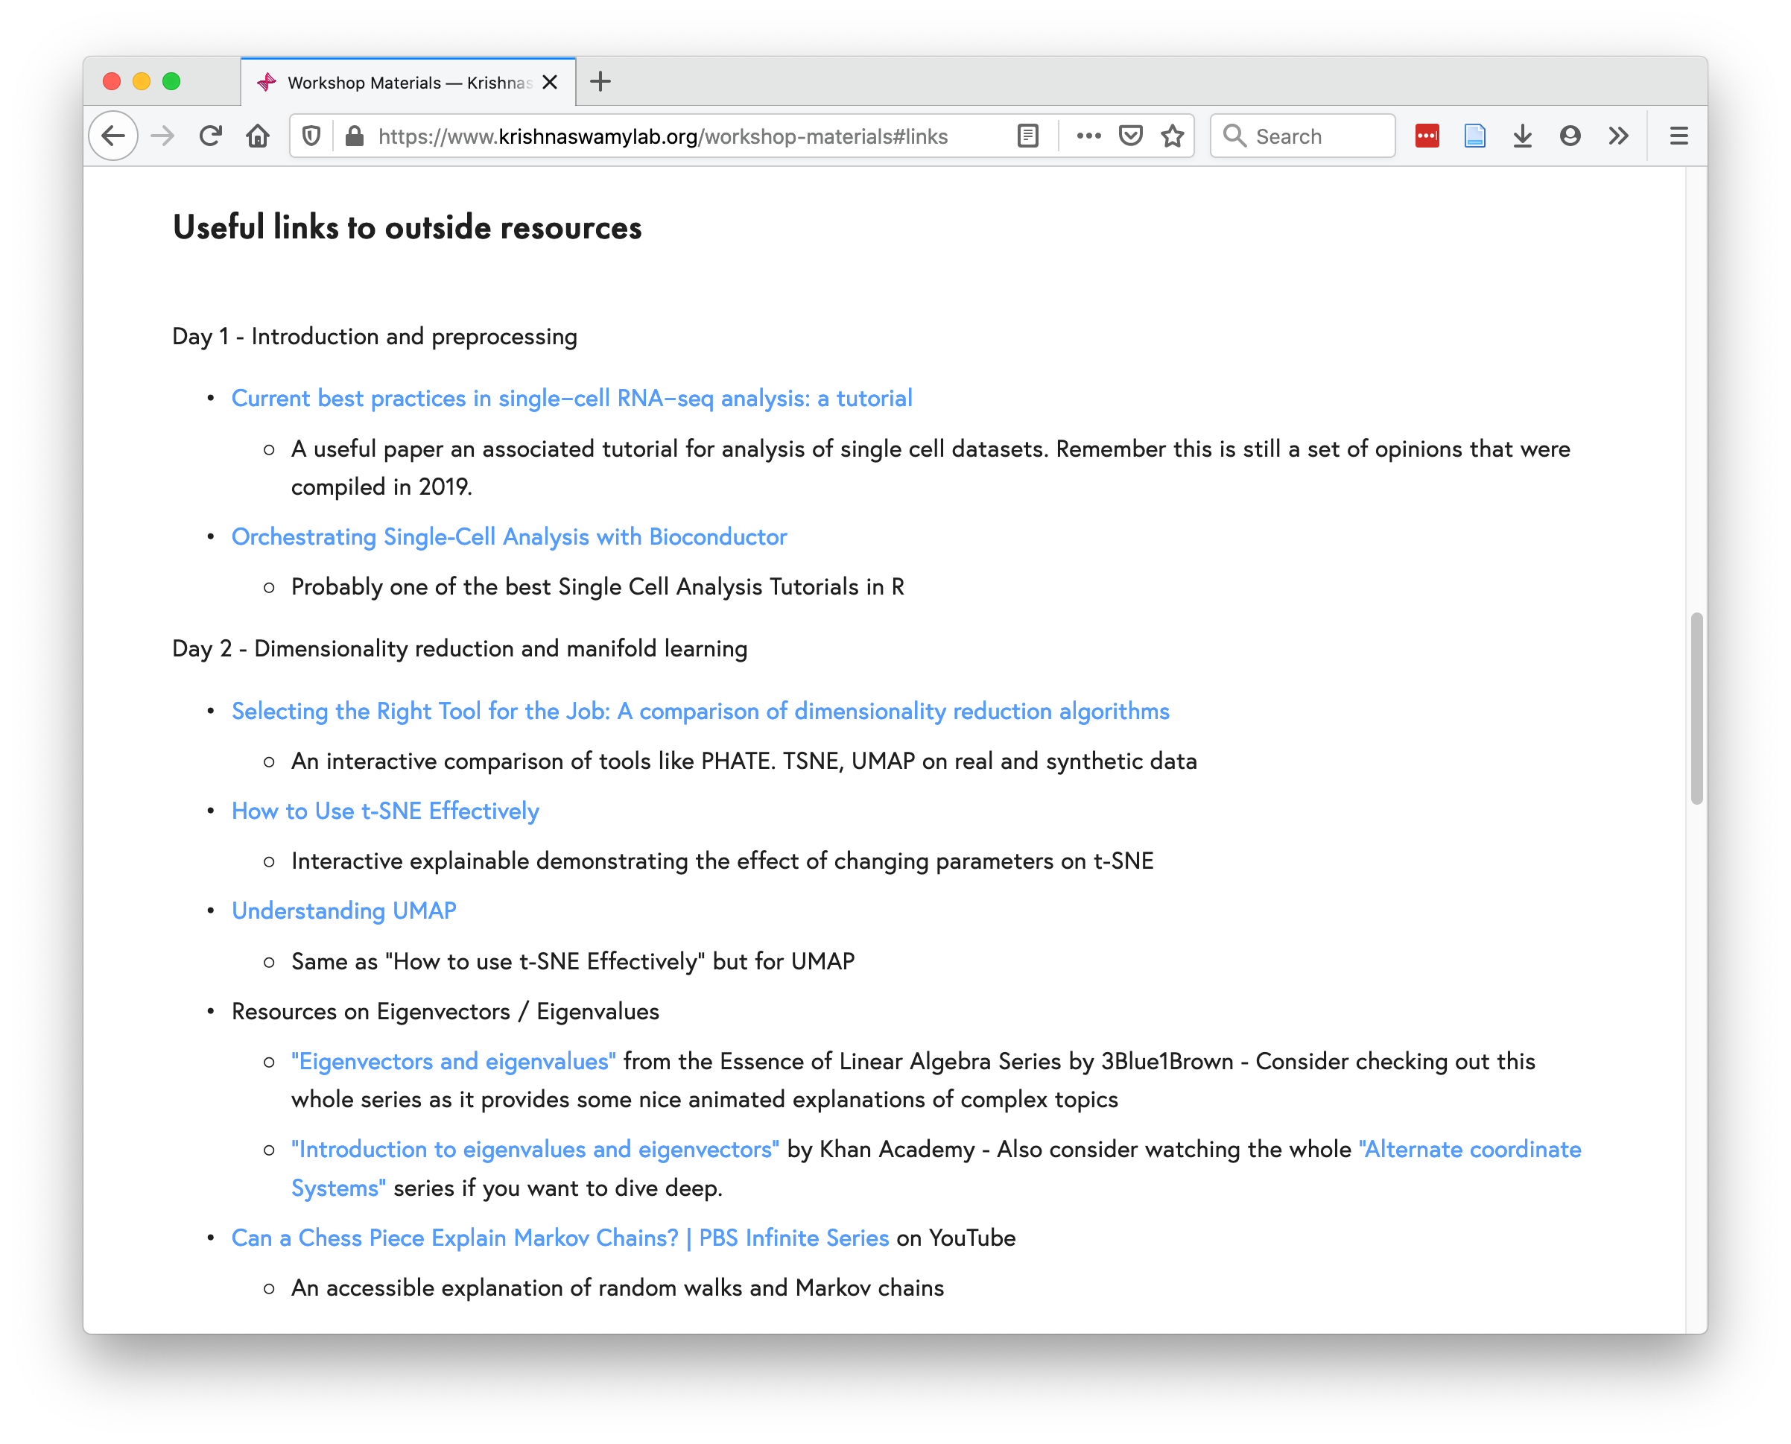
https://www.krishnaswamylab.org/workshop-materials#links

Slide 19
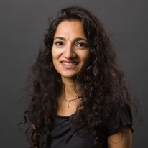
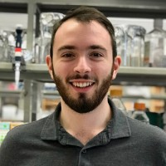

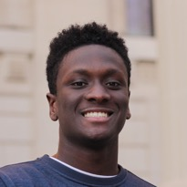




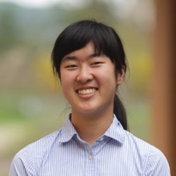


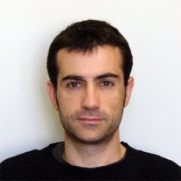
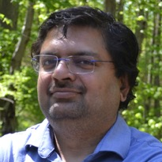


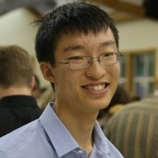
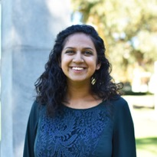


Smita Krishnaswamy
Daniel Burkhardt
Scott Gigante
Kofi Ansong
Andrew Benz
Egbert Castro
Pranik Chainani
Joanna Chen
Annie Gao
Michał Gerasimiuk
Wes Lewis
Francesc Lopez
Sameet Mehta
Sasha Safonova
Giacomo Scanavini
Alexander Tong
Aarthi Venkat
Max Yuan
Jeffrey Zhou
Giacomo Scanavini

Slide 20
@KrishnaswamyLab
#YaleML

Slide 21
Day 3: Denoising, Batch Correction, and Clustering
Notes:
TA introduction
Talk about not teaching code (not a programming workshop)

Slide 22
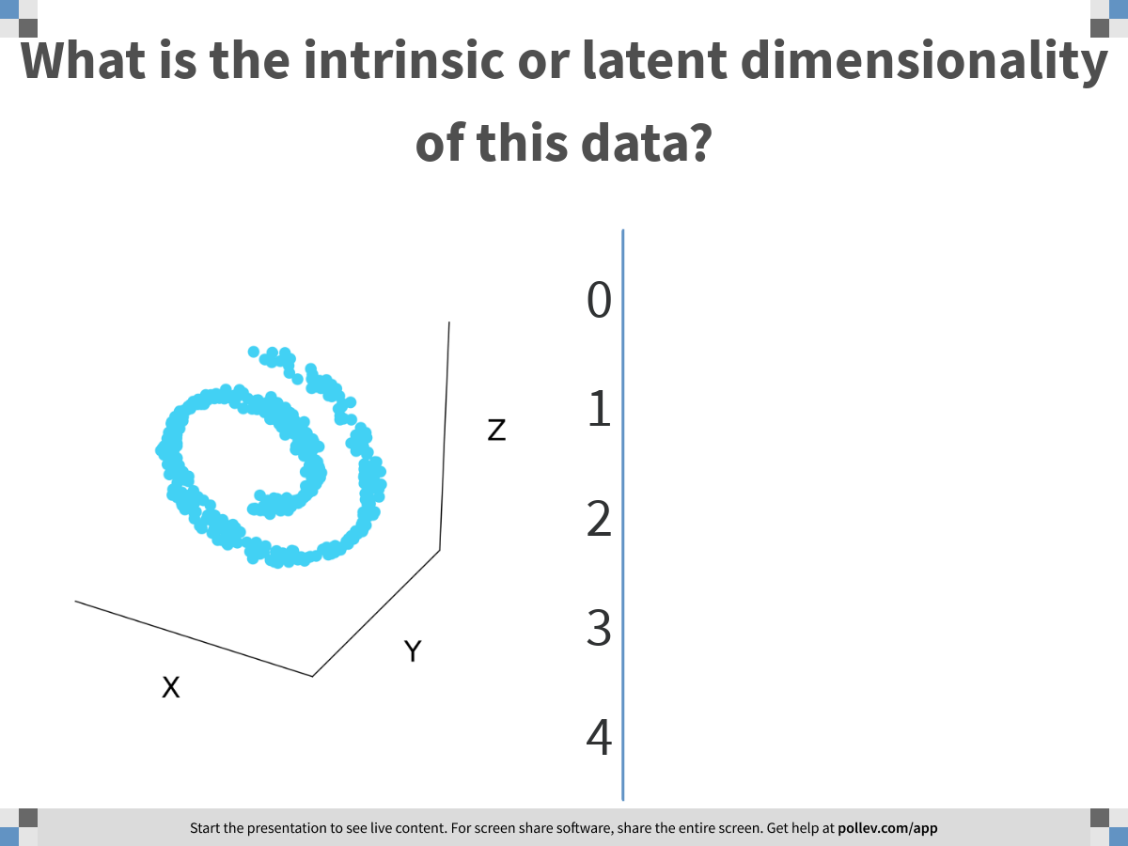
Notes:
What is the intrinsic or latent dimensionality of this data?
https://www.polleverywhere.com/multiple_choice_polls/VuedMRPvKyIBbCuDhPHwO

Slide 23
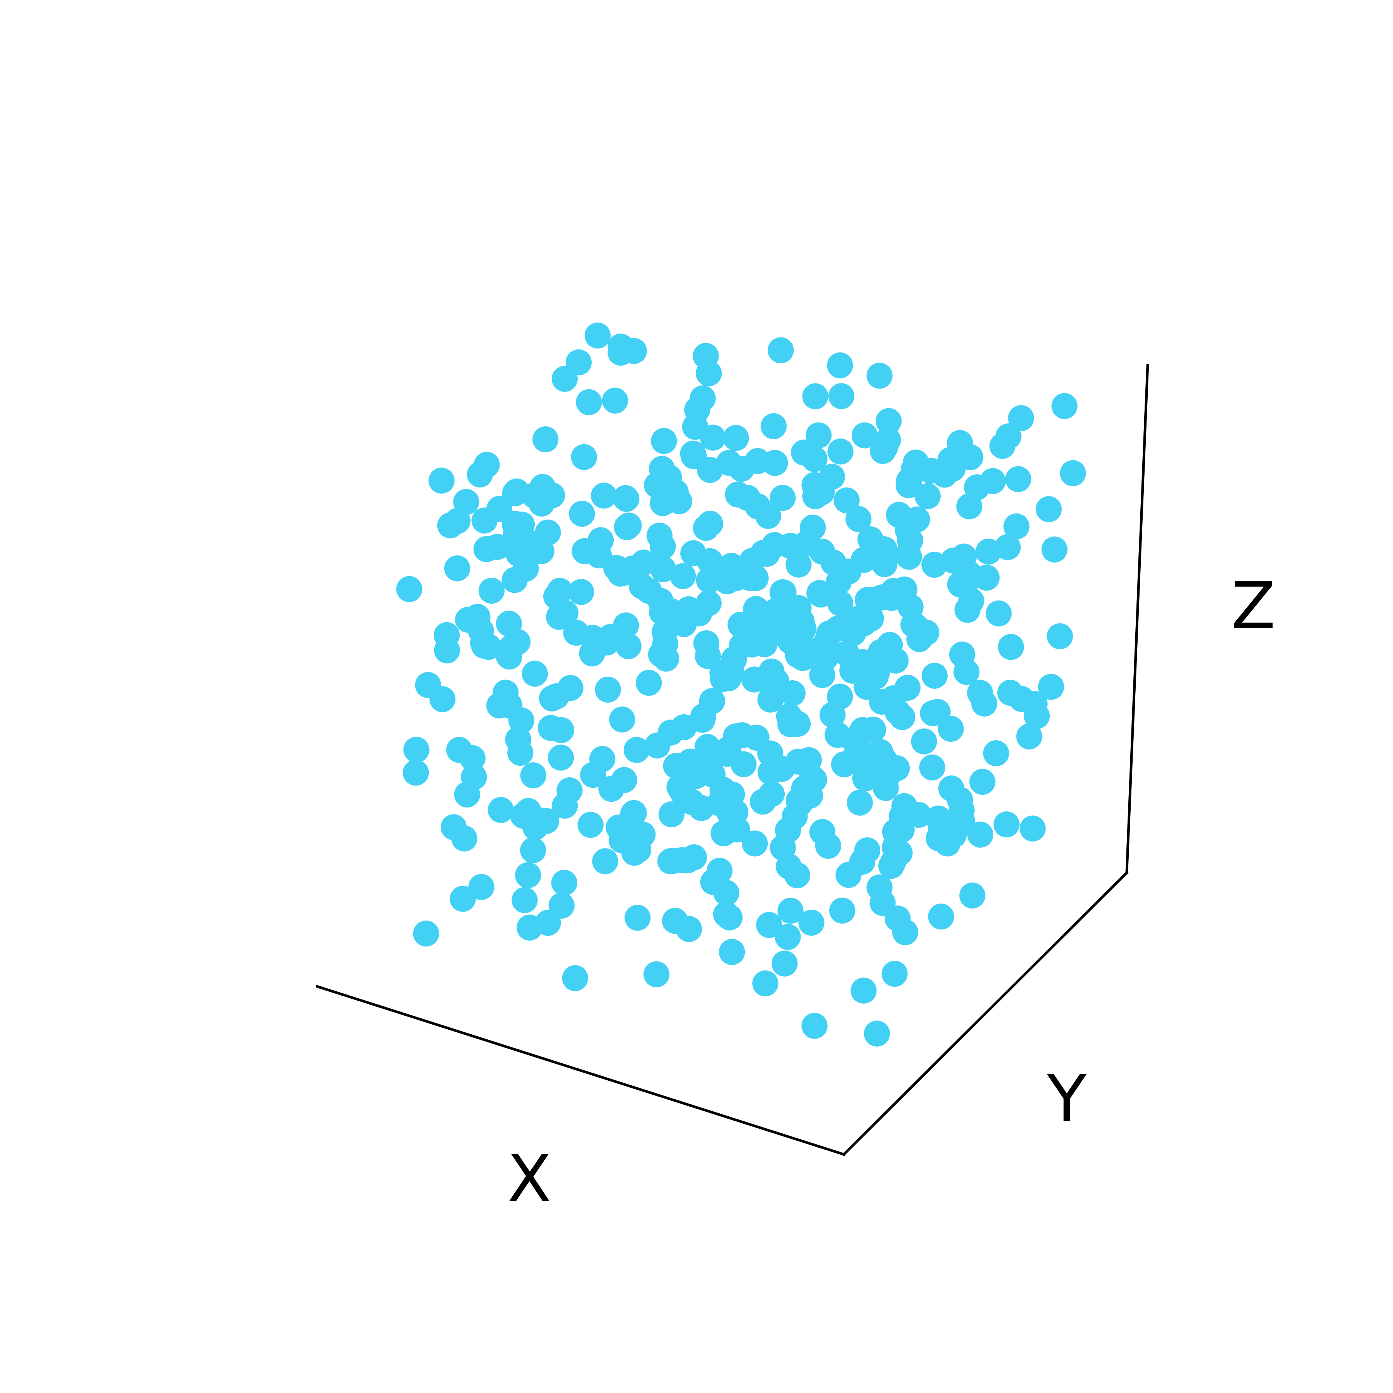
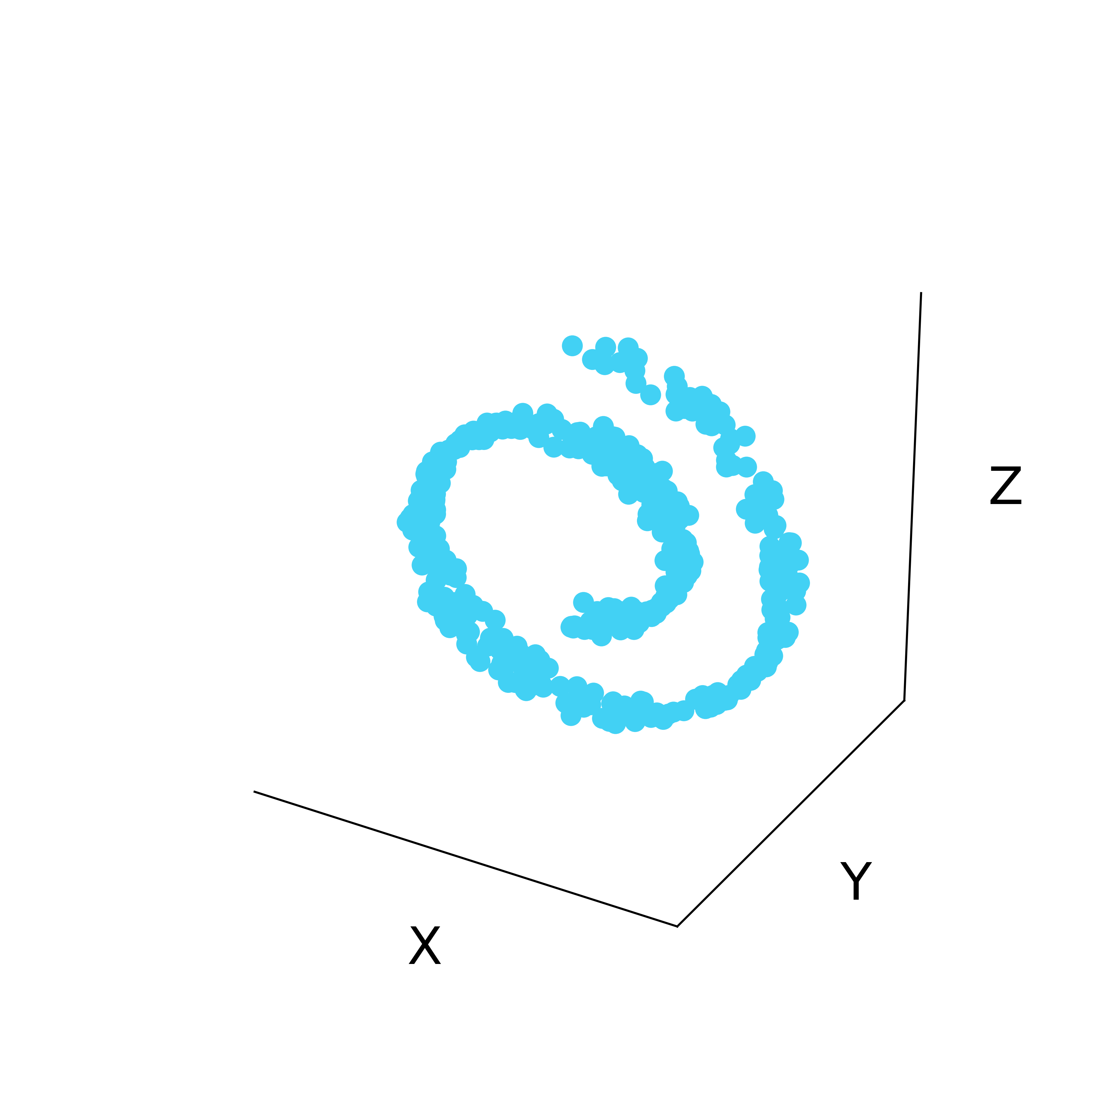
Latent structure in high dimensional data
Low-dimensional
manifold
Ambient Space

Slide 24
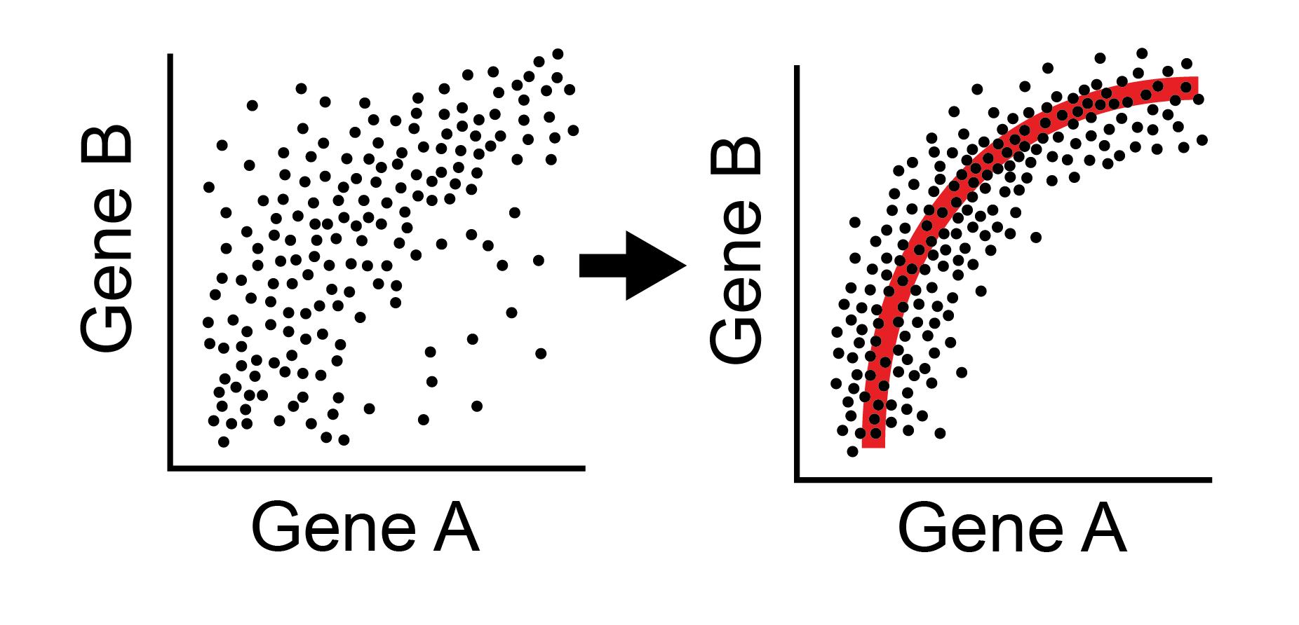
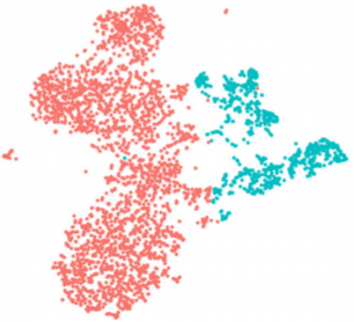
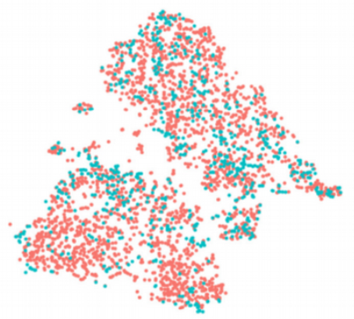
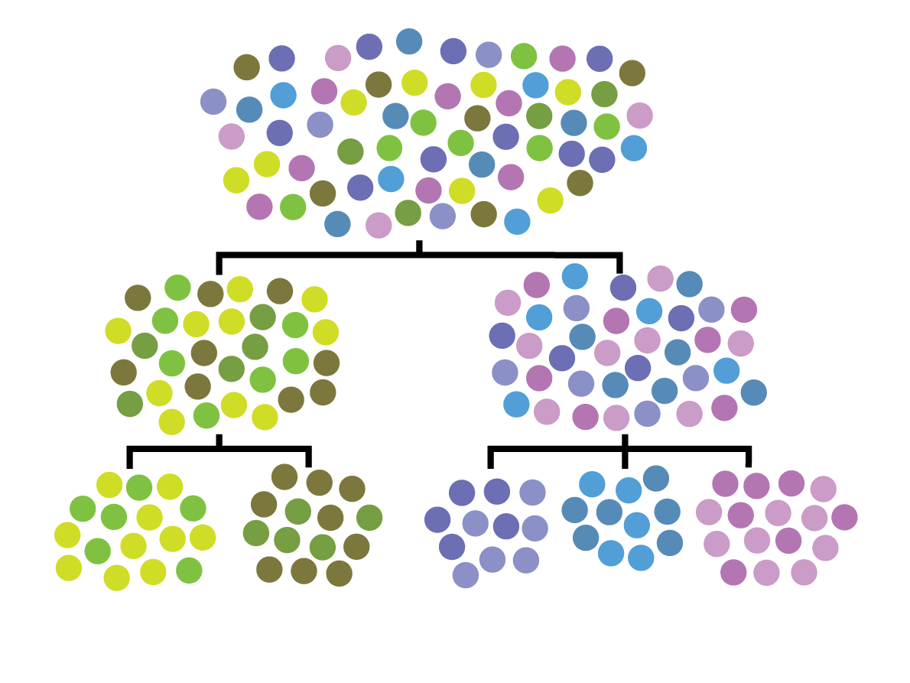
Other uses of affinity matrices, eigenvectors
Data Denoising
Batch normalization
Clustering
Data denoising and batch normalization
Clustering

Slide 25
Using the manifold model to denoise data
Notes:
TA introduction
Talk about not teaching code (not a programming workshop)

Slide 26

Denoising by eliminating dimensions
The number of dimensions in a data that are independent are called RANK
You can denoise data by lowering rank
Noisy image

Slide 27
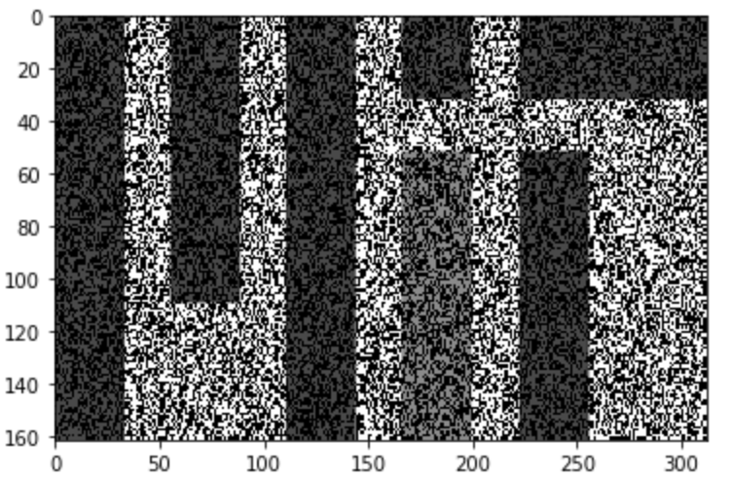
Recreate the data without noise
For this to work you have to have your dimensions be broken up into data dimensions and noise dimensions
Noisy image on the right is broken up into columns and rows instead
What do we do?

Slide 28

O cor
Notes:
How do we get dimensions that correspond to data "signal" and "noise" ?
https://www.polleverywhere.com/free_text_polls/3OVnyzZchdADfJIdZXVJf

Slide 29
PCA splits signal and noise
The axes with a lot of variation are likely to correspond to data
Axes with little variation correspond to noise directions
The amount of variation captured in each eigenvector is given by its eigenvalue
PC1 will have the highest eigenvalue, captures the most variation ..
PC2 next most
And so on…

Slide 30
SVD: Process similar to Eigendecomposition on non-square matrices
Singular values are eigenvalues of MM* or M*M
Singular vectors are eigenvectors of MM* or M*M
For a mean centered feature matrix the singular vectors U are also PCs

Slide 31
Low Rank approximation
Eliminate the singular vectors with low singular values and recreate the matrix

Slide 32


Low Rank Approximation on MIT matrix
Image from https://medium.com/@amelie_yeh/

Slide 33



Data is smooth, Noise is jumpy
Can take off noise by taking off low-eigenvalued eigenvectors

Slide 34

Notes:
How many eigenvectors should we use to reconstruct data? How many eigenvectors are noise? How do we know?
https://www.polleverywhere.com/free_text_polls/cCv6DTzZZalEfCgrnKGfB

Slide 35

Eigengap
Jumps in eigenvalues
Might give you a clue

Slide 36



Genes
Cells
Data is noisy and sparse (scRNA-seq)
Notes:
ideally: measure the expression of every gene in every
Samples only a small part of the transcriptome per cell
-- Tens of millions of individual measurements

Slide 37

Notes:
Can we use ideas from image denoising to denoise scRNA-seq data?
https://www.polleverywhere.com/free_text_polls/MHGsb8S3NA2p28T4r1NSd

Slide 38

Low rank approximation for non-linear data
Problem with PCA/Single Value Decomposition (SVD): it takes off linear dimensions in data, noise can be along the non-linear data manifold

Slide 39


Slide 40

Eigenvectors of Affinity Matrix

Slide 41





Eigenvectors are frequency harmonics
2nd Eigenvector
10th Eigenvector
2nd to last eigenvector

Slide 42

Cells are nodes, mRNA gene-counts are signals on a graph

Slide 43

Graph Fourier Transform

Slide 44


Slide 45

Notes:
How many eigenvectors should we take off?
https://www.polleverywhere.com/free_text_polls/P7vNDFrwpqLTCQM2o2TgV

Slide 46
MAGIC
Softly filters eigenvectors, down-weights them in a regular scheme rather than totally taking them off
This is called low-pass filtering on the spectrum of the graph

Slide 47


Imputation Step = Smoothing on Graph

Slide 48

Vertex Domain
Smooths signal on graph
Takes weighted average of neighbor

Slide 49

Low pass filter of Eigenvectors

Slide 50




Frequency domain
No Smoothing
T=2
Kills high frequency
noise
T=5
T=100

Slide 51

missing values
original data with dropout

Slide 52

imputation with MAGIC

Slide 53

imputation with MAGIC

Slide 54

imputation with MAGIC

Slide 55

imputation with MAGIC

Slide 56

imputation with MAGIC

Slide 57

imputation with MAGIC

Slide 58

What t should we choose?
Separate “learning phase” from “stable phase”, quit when data stabilizes

Slide 59

Molecular Validation
https://www.biorxiv.org/content/10.1101/786269v1.abstract

Slide 60

MAGIC recovers gene-gene relationships in an artificially dropped-out dataset

Slide 61
Denoising vs Missing value Imputation
Denoising assumes that data has some noise, all entries have noise added to them
Missing value completion methods assume that the existing values are correct and that some values are missing (not measured)
Matrix completion is a way of filling in missing values
There is some literature in the single cell world trying to differentiate between true zeros and false zeros
People disagree on how this should be done
With a denoising viewpoint it is not necessary to distingsuish

Slide 62

Comparing MAGIC to LRA and matrix completion

Slide 63

Notes:
For what tasks is denoising necessary?
https://www.polleverywhere.com/free_text_polls/FdXlmGtYUXmUKXSuYUtCb

Slide 64

Restoring expressions of characteristic markers

Slide 65

GFAP - marker for astrocytes
With MAGIC
Without MAGIC

Slide 66

Understanding Gene Gene Relationships

Slide 67
Summary of data denoising
Diffusing or smoothing values over a graph can denoise data
This kind of denoising is similar to averaging expression values across neighbors
More diffusion = more denoising
What questions do you have?
Please submit on Slack

Slide 68
Batch correction
Notes:
TA introduction
Talk about not teaching code (not a programming workshop)

Slide 69
Batch Effects in Single Cell
Systematic, non-biological differences between samples due to measurement conditions
Differences could be due to ambient conditions (temperature, humidity), machine calibration, differences in titration, bead/antibody batch, etc
Sometimes refers to actually actual biological differences but those that are “uninteresting” (background demographics rather than immediate drug effect).

Slide 70

Problem with Batch Effect
Samples become hard to compare
All genes, cell types seem different!

Slide 71
How do we detect batch effect?
Visualization!

Slide 72


Diversity Measures
Diversity measures including Shannon entropy have been used to quantify the degree of “mixture” between samples
kBet [Buttner et al] compare global population proportions to local
A priori, we don’t know what the degree of mixture should be, but if batch correction works, it should increase

Slide 73

Batch Correction
Take off artifactual variation and keep biological variation!

Slide 74

Can we use PCA to correct batch effect?

Slide 75

Notes:
How could we use PCA or SVD to remove batch effect?
https://www.polleverywhere.com/free_text_polls/A8BHLXdXtwjBoRMpT3G0E

Slide 76

This noise is large scale
Could be potentially addressed by removing first PC

Slide 77
Problem with PCA
It can address a linear shift in the data
But cannot handle more complex non-linear effects

Slide 78

Cannonical Correlation Analysis
CCA : uses a variant of PCA that brings two sets of samples to a common space
Can cluster or perform other analysis in common space but cannot go back to original space
Finds linear axes of common variation
Thrown off by non-matching populations

Slide 79

Harmonic Alignment
Aligns the diffusion components of two datasets using a rigid rotation that maximizes
correlation of gene loadings onto eigenvectors
Simple rotation does not seem to handle all cases

Slide 80
Mutual Nearest Neighbors
Creates a graph between two datasets
Nearest neighbors in the other dataset could be “matching cells”
But they have to be mutual!
Mutual neighbors
Non-mutual neighbors

Slide 81

Mutual Nearest Neighbors
Use MNNs to find out the direction of the batch effect and correct it.

Slide 82
MNN with MAGIC
B1
B2
Within 1
From 1->2
From 2->1
Within 2
Uses softer affinity matrix and pulls the data in to correct the result

Slide 83


Slide 84
MNN with MAGIC Correction

Slide 85

Notes:
Is mutual nearest neighbor (MNN) normalization linear or non-linear?
https://www.polleverywhere.com/multiple_choice_polls/mnsSK1uYGDPag7UUXFzhc

Slide 86
Summary of data denoising
Batch effects are sample-specific changes in measurements
The goal of batch-normalization is to align cells of the same “type” across samples
Mutual nearest neighbors (MNN) normalized batches by matching cells that are both close to each other
What questions do you have?
Please submit on Slack

Slide 87
Compositional Analysis
http://bit.ly/MELD_lecture
Notes:
TA introduction
Talk about not teaching code (not a programming workshop)

Slide 88
Single Cell Data
Samples
(1-10)
Cells
(1K – 10M)
Genes / Proteins
(10-10K)
http://bit.ly/MELD_lecture

Slide 89


Common experimental setup
Treat
Kernel used to build the graph
$$K\left(x_{i},x_{j}\right)=\exp\left(\frac{{\left\|x_{i}−x_{j}\right\|}^{2}}{2σ^{2} }\right)$$

Slide 90

Goal: Quantify difference in data density
Control
Data Density
Cell state

Slide 91

Goal: Quantify difference in data density
Control
After perturbation
Data Density
Data Density
Cell state
Cell state

Slide 92

Goal: Quantify difference in data density
Control
After perturbation
Effect of experiment
Data Density
Data Density
Δ Density
Cell state
Cell state
Cell state

Slide 93
Estimating sample density over a graph
Treat
Kernel used to build the graph
$$K\left(x_{i},x_{j}\right)=\exp\left(\frac{{\left\|x_{i}−x_{j}\right\|}^{2}}{2σ^{2} }\right)$$

Slide 94
Estimating sample density over a graph
Treat
Kernel used to build the graph
$$K\left(x_{i},x_{j}\right)=\exp\left(\frac{{\left\|x_{i}−x_{j}\right\|}^{2}}{2σ^{2} }\right)$$

Slide 95

Estimating sample density over a graph
Treat
Kernel used to build the graph
$$K\left(x_{i},x_{j}\right)=\exp\left(\frac{{\left\|x_{i}−x_{j}\right\|}^{2}}{2σ^{2} }\right)$$

Slide 96

Estimating sample density over a graph
Treat
Kernel used to build the graph
$$K\left(x_{i},x_{j}\right)=\exp\left(\frac{{\left\|x_{i}−x_{j}\right\|}^{2}}{2σ^{2} }\right)$$

Slide 97

Estimating sample density over a graph
Treat
Kernel used to build the graph
$$K\left(x_{i},x_{j}\right)=\exp\left(\frac{{\left\|x_{i}−x_{j}\right\|}^{2}}{2σ^{2} }\right)$$

Slide 98

Wagner D. et al. Science. 2018.

Slide 99


Slide 100


Slide 101

Analysis of replicates reveals heterogenous response

Slide 102
Analysis of replicates reveals heterogenous response

Slide 103

Analysis of replicates reveals heterogenous response

Slide 104


Chd Relative Likelihood

Slide 105
Chd Relative Likelihood

Slide 106



RL
Chd Relative Likelihood

Slide 107




bit.ly/quantsinglecell
github.com/KrishnaswamyLab/MELD
Coming soon!

